Slide 1
MEMBER NAME BITS ID
LAKSHYA AGARWAL 2017B5A70904P
NAGA SIVA SAI REDDY 2017B3A70779P
RAHUL PODDAR 2017B3A70746P

Slide 2
Message Passing Attention Networks for Document Understanding
Giannis Nikolentzos,¹ Antoine J.-P. Tixier,¹ Michalis Vazirgiannis^{1,2}
¹Ecole Polytechnique ́ ²Athens University of Economics and Business

Slide 3
Aim
Graph Neural Networks(GNNs ) are successfully applied in major fields of science and engineering like Biology, Chemistry and Computer Vision.
In this work, authors experimented with Message Passing Attention mechanism of GNNs on one of the most important task of NLP - Document understanding(text classification) with an aim to build State-of-the-Art networks using GNNs.
Paper aims at exploiting the strength of co-occurrence networks as a form of representation of documents in context of GNNs
Authors also aim at studying the usefulness of a Attention mechanism in GNNS by proposing several hierarchical variants of Message Passing Attention Network for Documents (MPAD).

Slide 4
Methodology
Core idea of recursive neighborhood aggregation is employed. That is, at every iteration, the representation of each vertex is updated based on messages received from its neighbors.
Message Passing(MP) consists of an aggregation phase followed by a combination phase.
Messages are passed for T time steps. Each step is implemented by a different layer of the MP network. Hence, iterations correspond to network depth.
For the final classification or regression, a readout pooling function, that is invariant to permutations, is applied.

Slide 5
Final Outcomes
MPAD achieves best performance on 5 out of 10 text-classification datasets, and is close second elsewhere.
The 5 datasets on which MPAD ranks first widely differ in training set size, number of categories, and prediction task (topic, sentiment, etc.), which indicates that MPAD can perform well in different settings.
On 9 datasets out of 10, one or more of the hierarchical variants outperform the vanilla MPAD architecture.
MPAD is sensitive to word order and word-word relationship strength which is very essential for proper document classification. This is happening through processing of weighted, directed word co-occurrence networks.

Slide 6
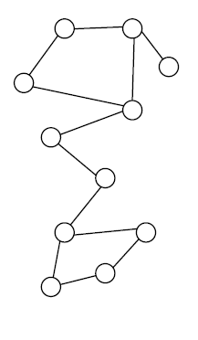
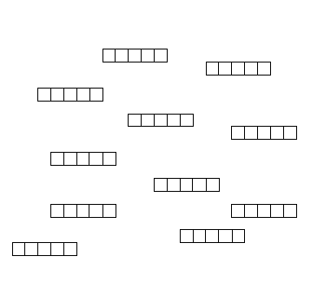

Background Concepts: Why Learning Node Representation?
Node Classification
Anomaly
Detection
Link Prediction
Clustering
Recommendation
& so on….
Better representation of text by extraction of word-to-word relationship is effective for many applications, as shown above.
Co-occurrence graph representation
Embedding for words

Slide 7
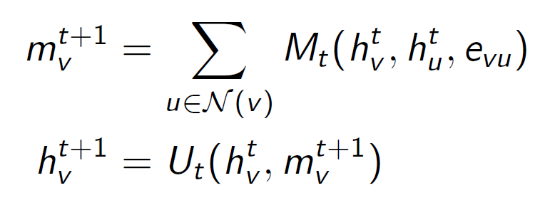
Background Concepts
Idea: Each node exchanges messages with its neighbors and updates its representations based on these messages
The message passing scheme runs for T time steps and updates the representation of each vertex h^{t}_{v} based on its previous representation and the representations of its neighbors:
where N(v) is the set of neighbors of v and M^{t} , U^{t} are message functions and vertex update functions respectively

Slide 8
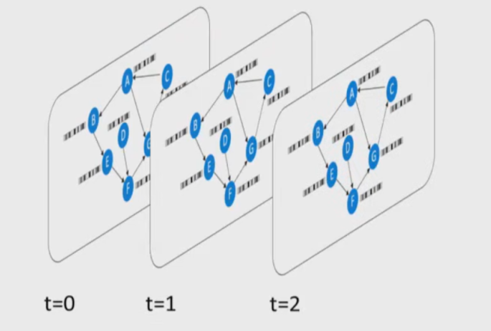
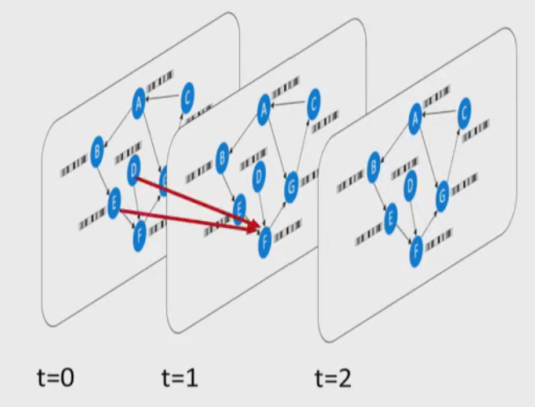
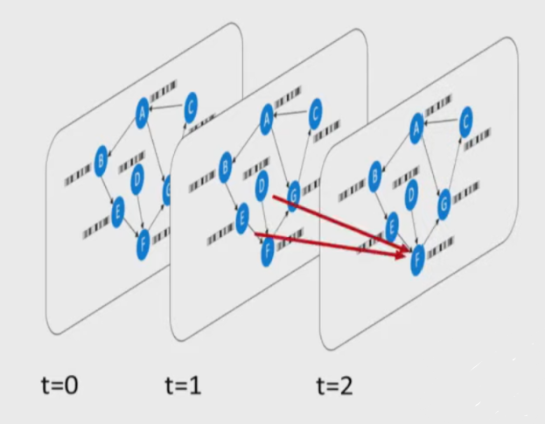
Message Passing

Slide 9
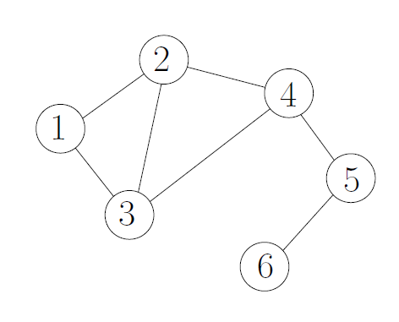
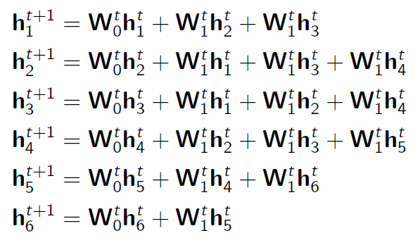
Example of Message Passing Scheme
At each iteration, the embeddings are updated based on the “messages” passed by neighbour vertexes
Remark: Biases are omitted for clarity

Slide 10


Example of Read-out phase
Output of message passing phase:
Graph representation:

Slide 11
Dataset Details
The datasets used in the original study are:
Reuters- contains stories from the Reuters news agency.
BBC Sport contains sports news articles from the BBC Sport website.
Polarity features positive and negative labeled snippets from Rotten Tomatoes.
Subjectivity contains movie review snippets from Rotten Tomatoes (subjective sentences), and IMDB plot summaries.
MPQA is made of positive and negative phrases, annotated as part of the summer 2002 NRRC Workshop on Multi-Perspective Question Answering.
IMDB is a collection of highly polarized movie reviews (positive/negative).
TREC consists of questions that are classified into 6 different categories.
SST-1 contains the same snippets as Polarity, split into multiple sentences and annotated with fine-grained polarity (from very negative to very positive).
SST-2 is the same as SST-1 but with neutral reviews removed and snippets classified as positive or negative.
Yelp2013 features reviews obtained from the 2013 Yelp Dataset Challenge.

Slide 12
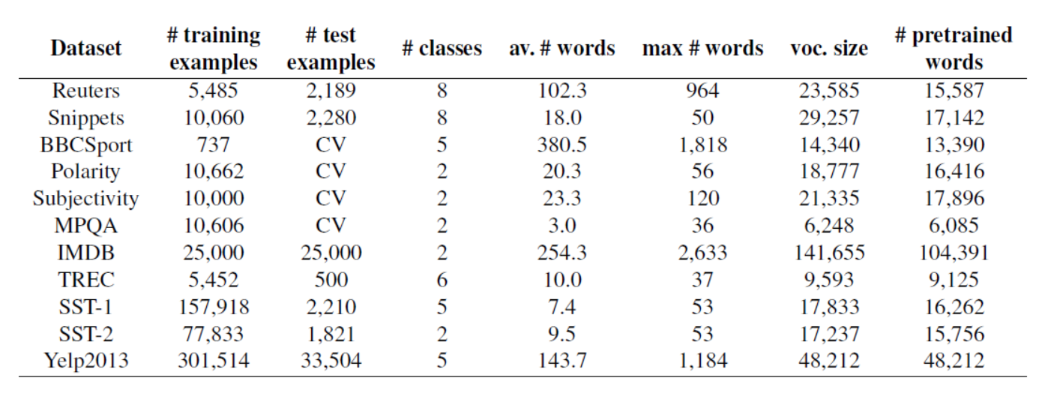
Dataset Details

Slide 13
Details of selected datasets used by us
Polarity features positive and negative labeled snippets from Rotten Tomatoes - Binary sentiment analysis dataset.
TREC consists of questions that are classified into 6 different categories - Topic Modelling dataset.
SST-1 contains the same snippets as Polarity, split into multiple sentences and annotated with fine-grained polarity (from very negative to very positive) - Multi-class sentiment analysis dataset.
DRIVE LINK: https://drive.google.com/drive/folders/1x8ZKWl3JQl687d5Zg3Lf4Kfi-IRgkaPA?usp=sharing

Slide 14
Implementation details

Slide 15
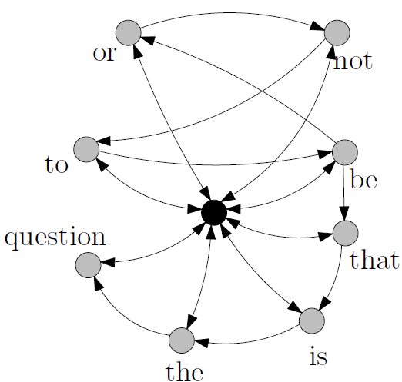
Representation of text as Word Co-occurrence Networks
Each document is represented as a graph G = (V; E) consisting of a set V of vertices and a set E of edges between them
vertices -> unique terms
edges -> co-occurrences within a fixed-size sliding window
vertex attributes -> embeddings of terms
G is directed and weighted: edge directions and weights respectively capture text flow and co-occurrence counts.
Graph representation more flexible than n-grams
Figure: Graph representation of doc: “to be or not to be: that is the question” The black node corresponds to the master node

Slide 16


Message passing
Our Aggregate function is:
where H^{t} 𝞊 R^{n x d} contains node features (d is a hyperparameter) & A 𝞊 R^{n x n} is the adjacency matrix of G having zero as diagonal.
G is weighted, the i^{th} row of A contains the weights of the edges incoming on node v_{i}. D ∈ R^{nxn} is the diagonal in-degree matrix of G. MLP denotes a multi-layer perceptron, and M^{t+1} ∈ R ^{nxd} is the message matrix.
Our Combine function is:

Slide 17
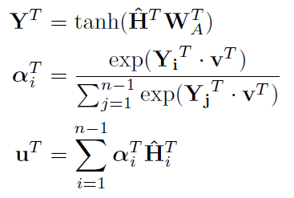
Readout
After passing messages and performing updates for T iterations, we obtain a matrix H^{T} ∈ R^{n×d} containing the final vertex representations. Let Ĝ be graph G without the special document node and its adjacent edges, and matrix Ĥ^{T}∈R^{(n−1)×d} be the corresponding representation matrix.
We apply a global self-attention mechanism to the rows of Ĥ^{T}.
Ĥ^{T} is first passed to a dense layer parameterized by matrix W^{T}_{A}∈ R^{d×d}. An alignment vector α is then derived by comparing, via dot products, the rows of the output of the dense layer Y^{T} ∈ R^{(n−1)×d} with a trainable vector v^{T} ∈ R^{d} and normalizing with a softmax. The normalized alignment coefficients are finally used to compute the attentional vector u^{T} ∈ R^{d} as a weighted sum of the final representations Ĥ^{T}.

Slide 18
Execution Flowchart
Remove non-alphabetical characters.
Transform sentences to lower case.
Separate sentences for hierarchical MPAD.
Pre-processing
Assign word2vec embedding for each vertex(word).
Create graph of word embedding using unique words with edge weights as strength of co-occurrence.
Graphical Representation
Use AGGREGATION, COMBINATION and READOUT.
Build T layers of message passing networks with attention mechanism.
This uses normal fully connected layers with batch normalisation as fundamental blocks.
Use dropout to prevent overfitting.
Build MPAD
Train the model for 200 epochs with a patience of 20 for early stopping.
Configuration: Adam optimizer, Step learning rate schedule with gamma as 0.5 and step size as 50
Plot accuracy, loss and F1 score during training.
Perform testing or cross validation accordingly.
Training and Testing

Slide 19
Results

Slide 20
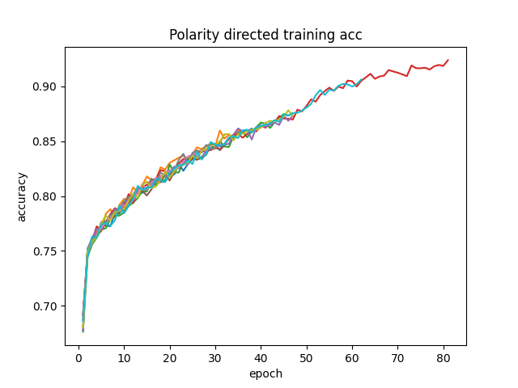
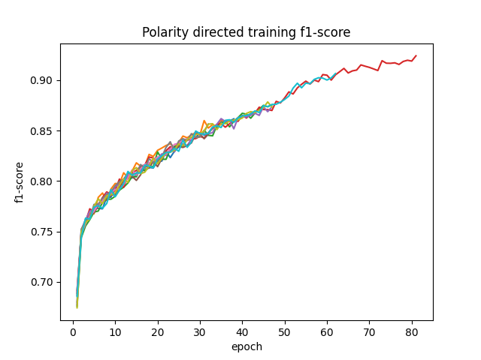
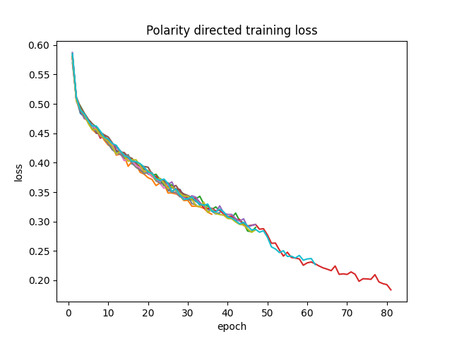
Vanilla MPAD - Polarity
Avg Accuracy: 0.80107
Avg F1 score: 0.88010
Avg Precision: 0.98334
Avg Recall: 0.80107
**Author’s Accuracy: 0.8024
***Note that multiple lines for Polarity loss,acc & f1 due
to multiple testings happening during cross validation

Slide 21
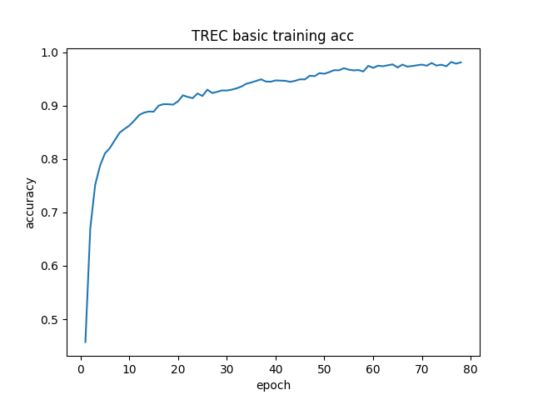
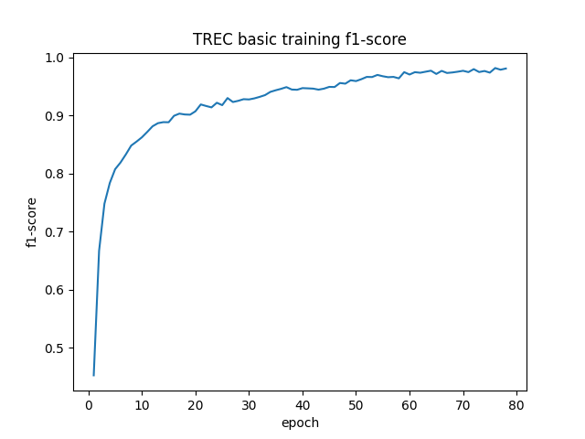
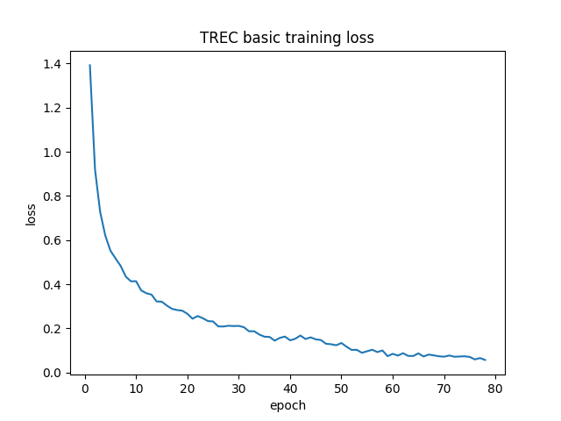
Vanilla MPAD - TREC
Accuracy= 0.92800
F1 score= 0.92683
Precision= 0.93004
Recall= 0.92800
**Authors’ accuracy= 0.9560
Note: Vocab size obtained: 8764 & vocab size mentioned in paper: 9593

Slide 22
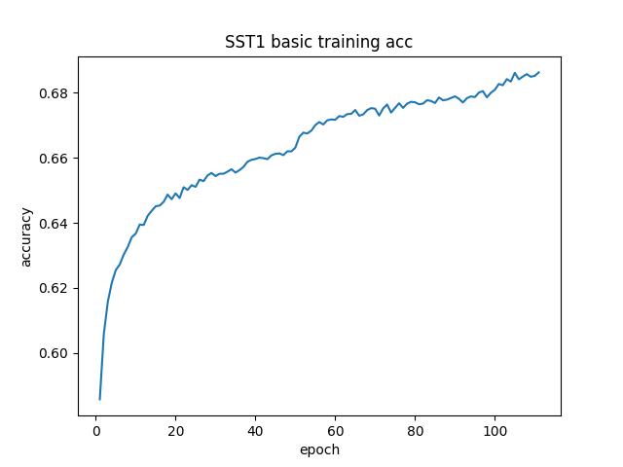
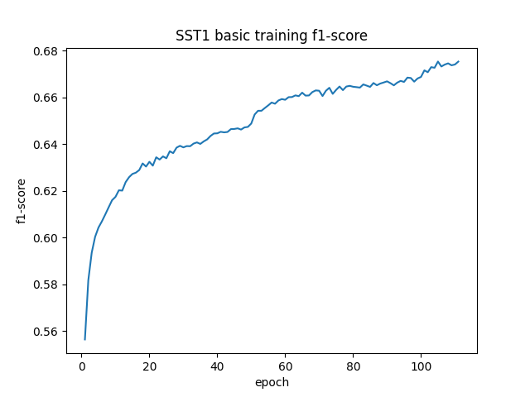
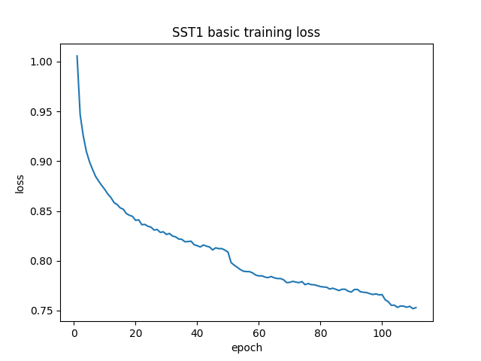
Vanilla MPAD - SST1
Accuracy = 0.45747
F1 Score = 0.43694
Precision = 0.52162
Recall = 0.45747
**Author’s Accuracy = 0.4909

Slide 23
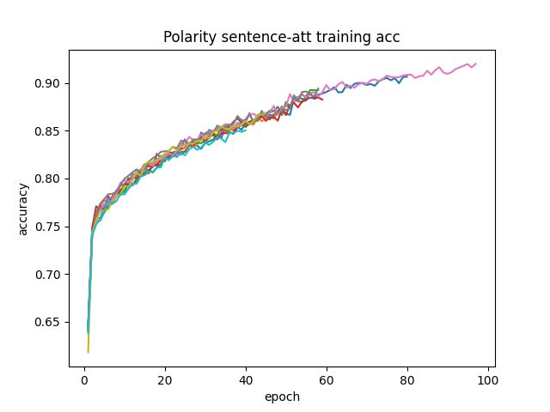
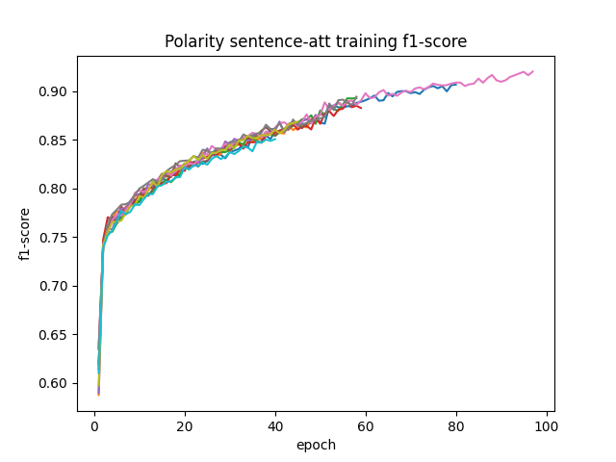
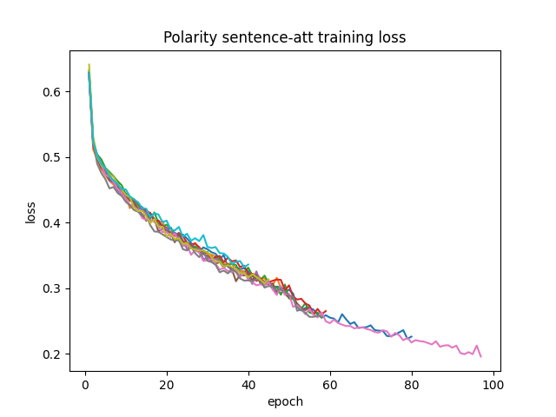
Hierarchical MPAD(Sentence Attenuation)- Polarity
Accuracy: 0.80491
F1 score: 0.88368
Precision: 0.98484
Recall: 0.80491
**Author’s accuracy: 0.8044
***Note that multiple lines for Polarity loss,acc & f1 due
to multiple testings happening during cross validation

Slide 24
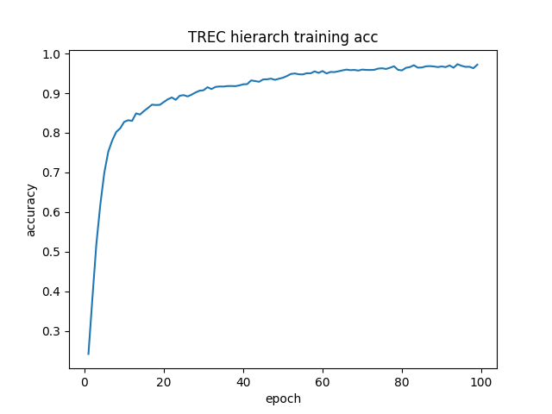
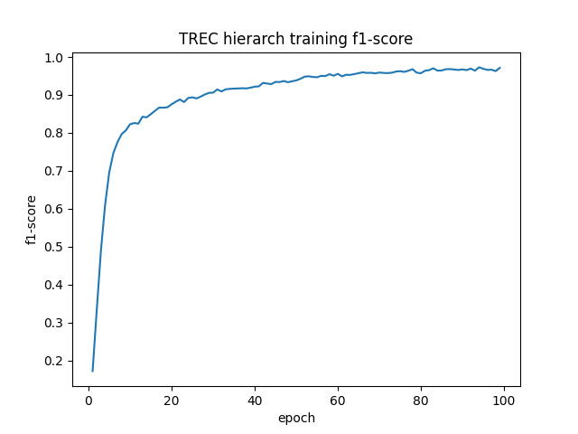
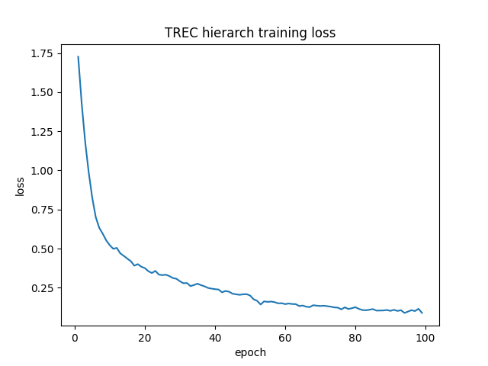
Hierarchical MPAD(Sentence Attenuation)- TREC
Accuracy: 0.93200
F1 score: 0.93151
Precision: 0.93165
Recall: 0.93200
**Author’s accuracy: 0.9560

Slide 25
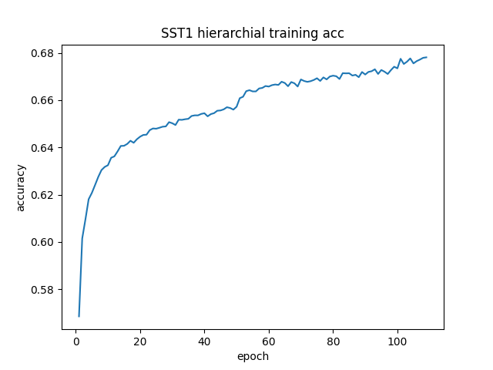
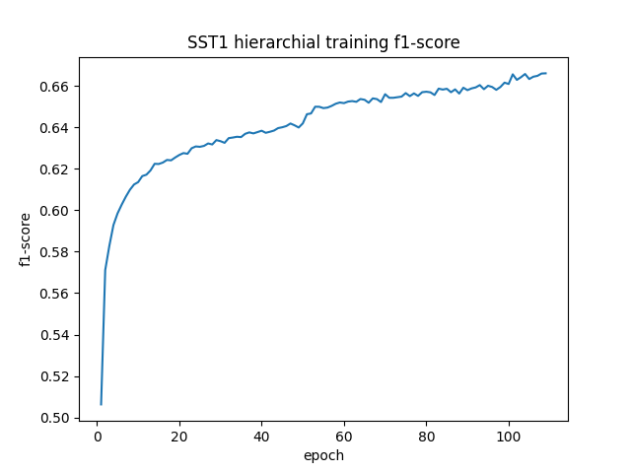
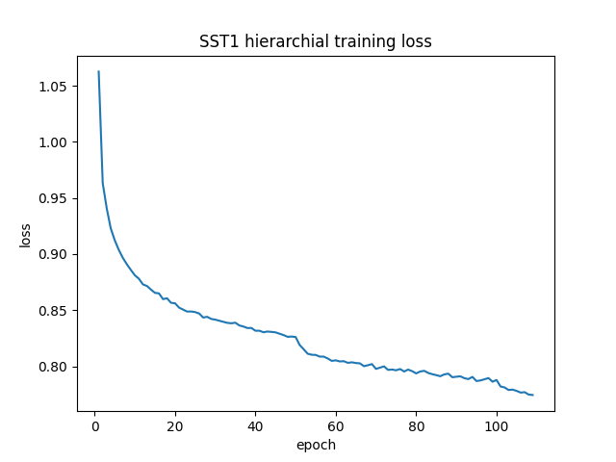
Hierarchical MPAD(Sentence Attenuation)- SST1
Accuracy: 0.38326
F1 score: 0.34690
Precision: 0.54263
Recall: 0.38326
**Author’s accuracy: 0.4995

Slide 26
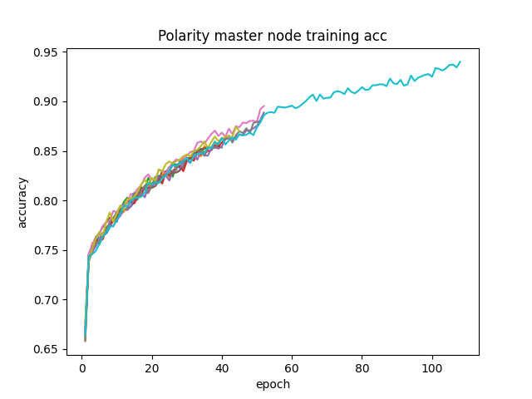
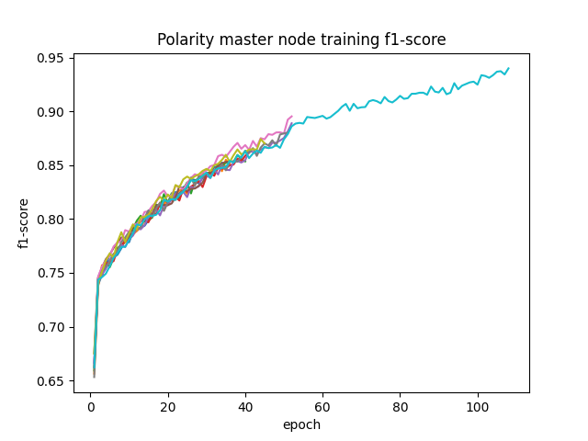
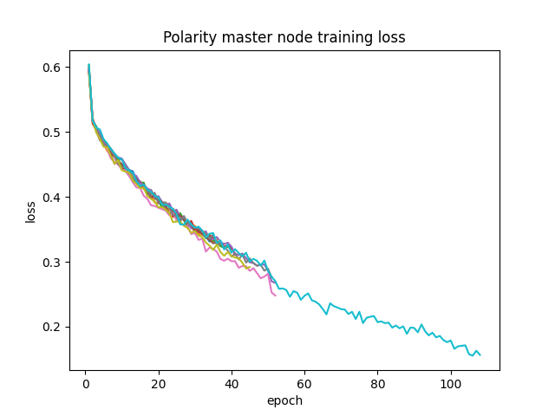
Ablation Studies : Polarity : No Master Node
Avg Accuracy: 0.79234
Avg F1 score: 0.87574
Avg Precision: 0.98542
Avg Recall: 0.79234
Author’s accuracy: 0.7915
***Note that multiple lines for Polarity loss,acc & f1 due
to multiple testings happening during cross validation

Slide 27
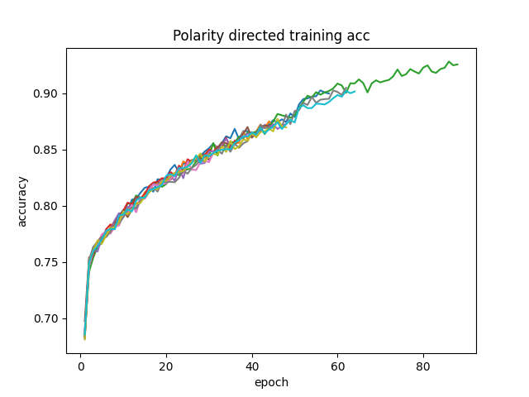

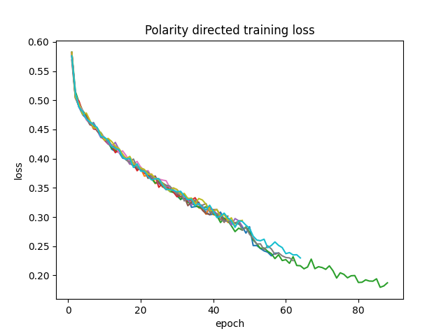
Ablation Studies : Polarity : Undirected Edges
Avg Accuracy: 0.80229
Avg F1 score: 0.88238
Avg Precision: 0.98672
Avg Recall: 0.80229
Author’s accuracy: 0.8005
***Note that multiple lines for Polarity loss,acc & f1 due
to multiple testings happening during cross validation

Slide 28
Challenges faced in implementation
Understanding the process of graphical-representation of sentences, which is the main aspect of the paper is challenging.
The final results presented by authors are very sensitive to the random-seed (used by pytorch modules). So we had to run the code for multiple times to get nearby results.
Finding & formatting the datasets was also not simple, as there are multiple versions of the datasets available and it’s not clearly mentioned which version of datasets to be used.
As the application of GNNs to NLP is relatively new, there are less resources available to learn the concepts from.

Slide 29
To modularize the code separately for two different types of final evaluations i.e., cross-validation(for Polarity) & testing(for TREC & SST1) was also challenging , as it requires major changes in the graph representation of sentences.
Less computational power available is a severe limitation , particularly when training with larger datasets like SST1(which has more than 150K samples).

Slide 30
Future Scope
The MPAD framework has been used by authors for sentiment analysis and topic modelling. The framework can be extended to other important tasks of NLP like Question answering, Named entity recognition, Part-of-speech tagging as these tasks demand good understanding of word order and word-to-word relationship strength which MPAD is good at.
Different types(& variants) of functions can be experimented for AGGREGATION, COMBINE & READ-OUT in-place of current functions.
The mechanism of MPANN can be incorporated in retrieval of word-embeddings in an unsupervised manner. And these embeddings are best customized to the datasets separately than static word-embeddings like word2vec, fasttext etc.,
A combination of ablation of using a master node which has weights associated with its edges to individual nodes can be experimented with.

Slide 31
Learning outcomes
We understood how GNNs acts like a higher level of relationship extractors between words of document, building upon word embeddings(word2vec) which are themselves extracted in an unsupervised way, preserving the semantics of text.
We learned how GNNs can outperform standard techniques of neural networks in multiple subfields of ML like Computer Vision and NLP
Our knowledge of Pytorch and SKLearn frameworks is enhanced.
This assignment taught us how to implement classroom learning into real problem solving.

Slide 32
Thank You !!!

